Slide 1
(Church Name Here) MISSION TRIP ROATAN
(Enter Date Here)

Slide 2
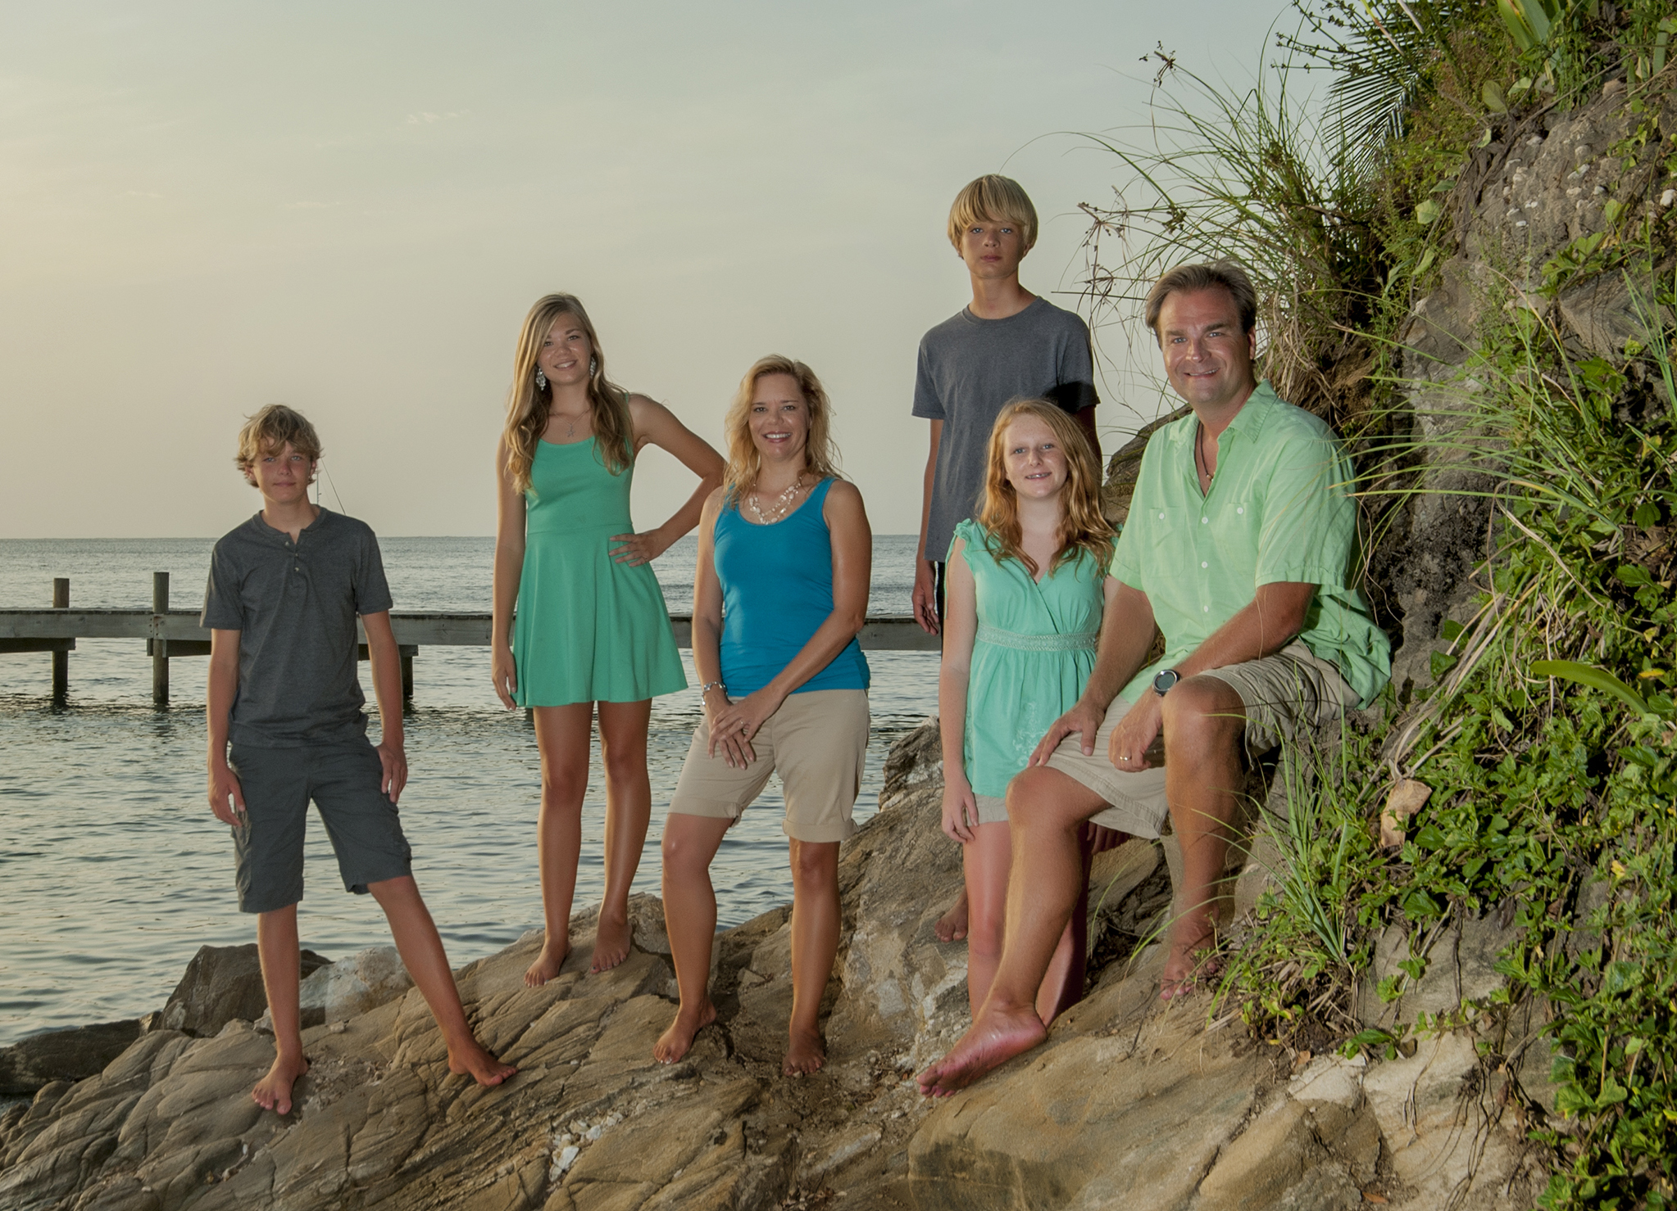
www.ROATANMISSION.com

Slide 3
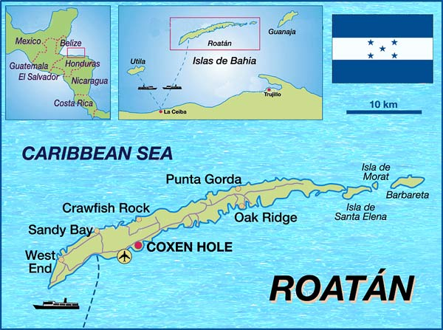

Slide 4
Fast Facts About Honduras
Honduras has the highest murder rate in the world. San Pedro on the mainland is most dangerous city.
Roatan is very safe to visit and minister
Second highest AIDS rate in world
Unemployment rate is 56%
The population is around 8 million (80,000 on Roatan)

Slide 5
^{Our FOCUS}
Churches

Slide 6
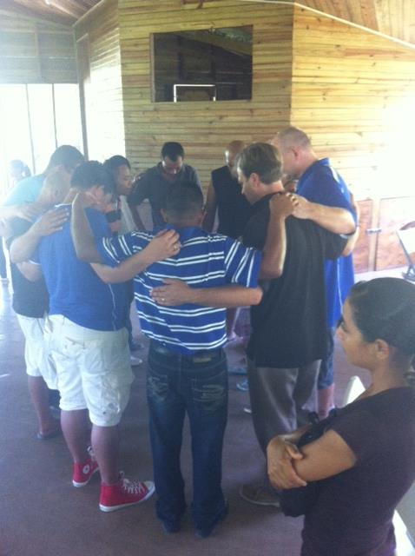
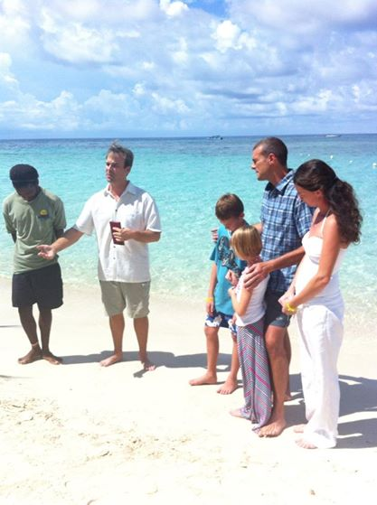
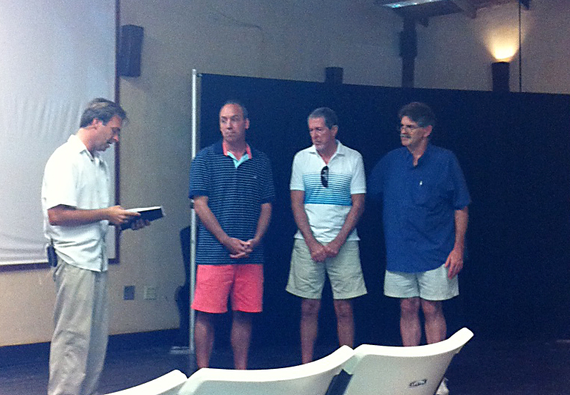
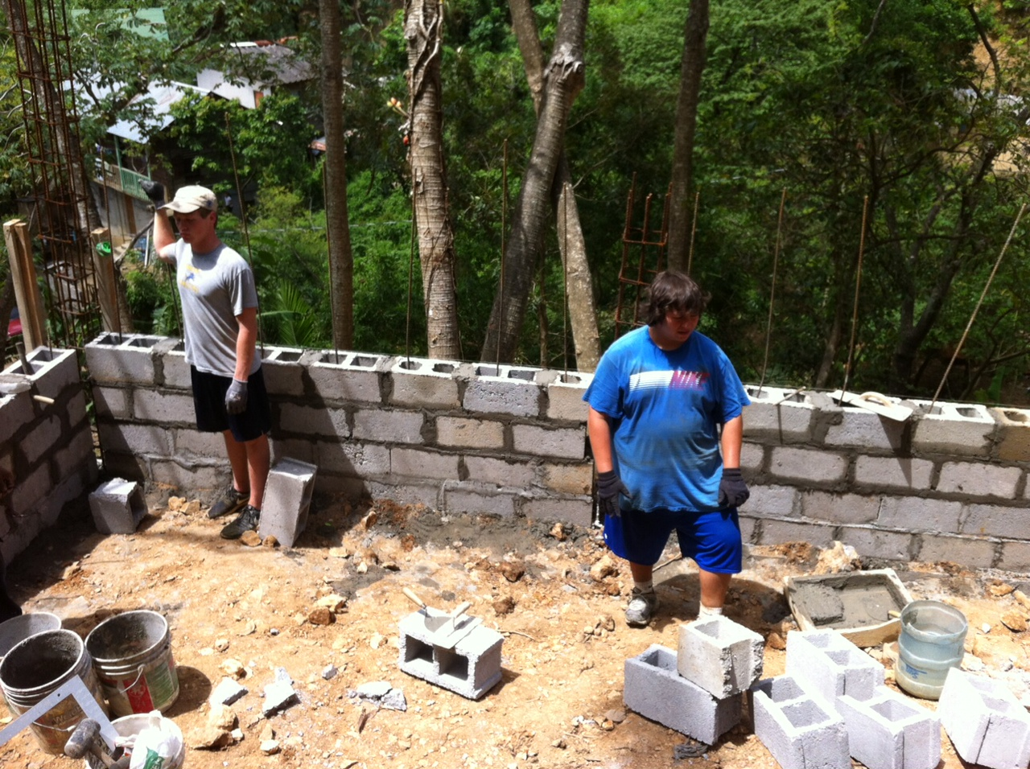
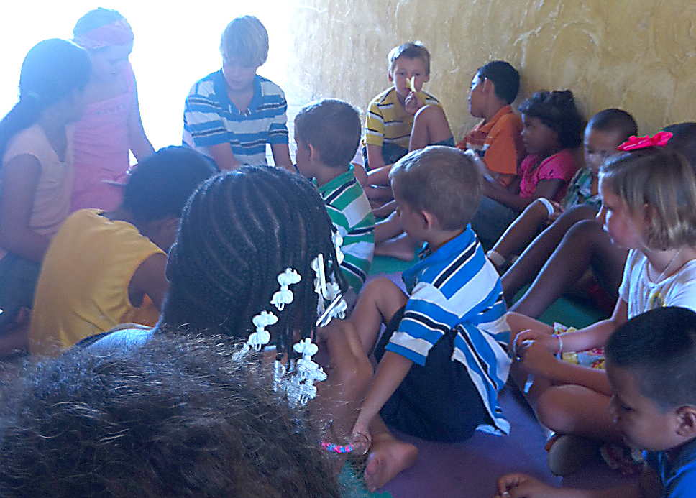

Slide 7
^{Our Ministry Opportunities}
Orphanage
Dump Ministry
Church Planting/Construction
Mentoring/Tutoring Christian School
VBS
Medical Missions

Slide 8
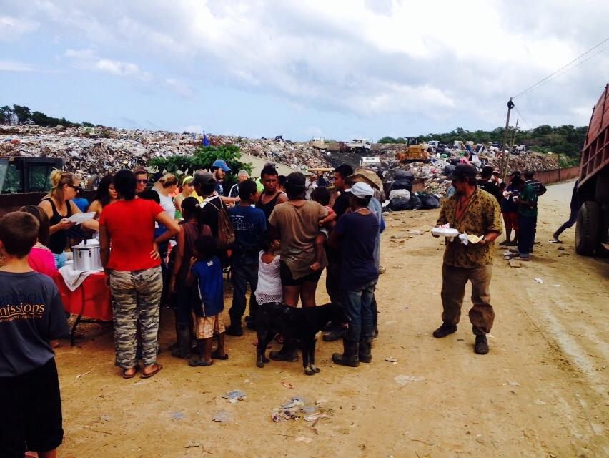

Slide 9
^{Our FOCUS}
Churches
Counseling
Dump Ministry
Orphanages
Mission Teams

Slide 10
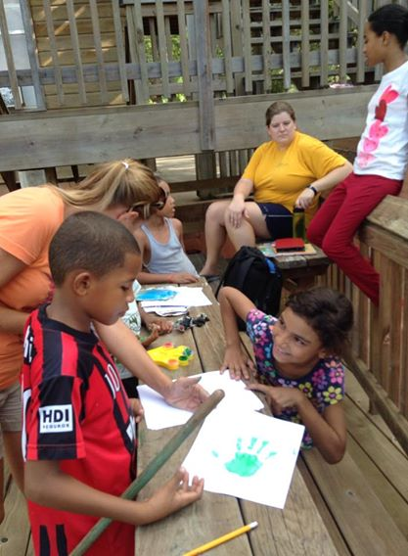
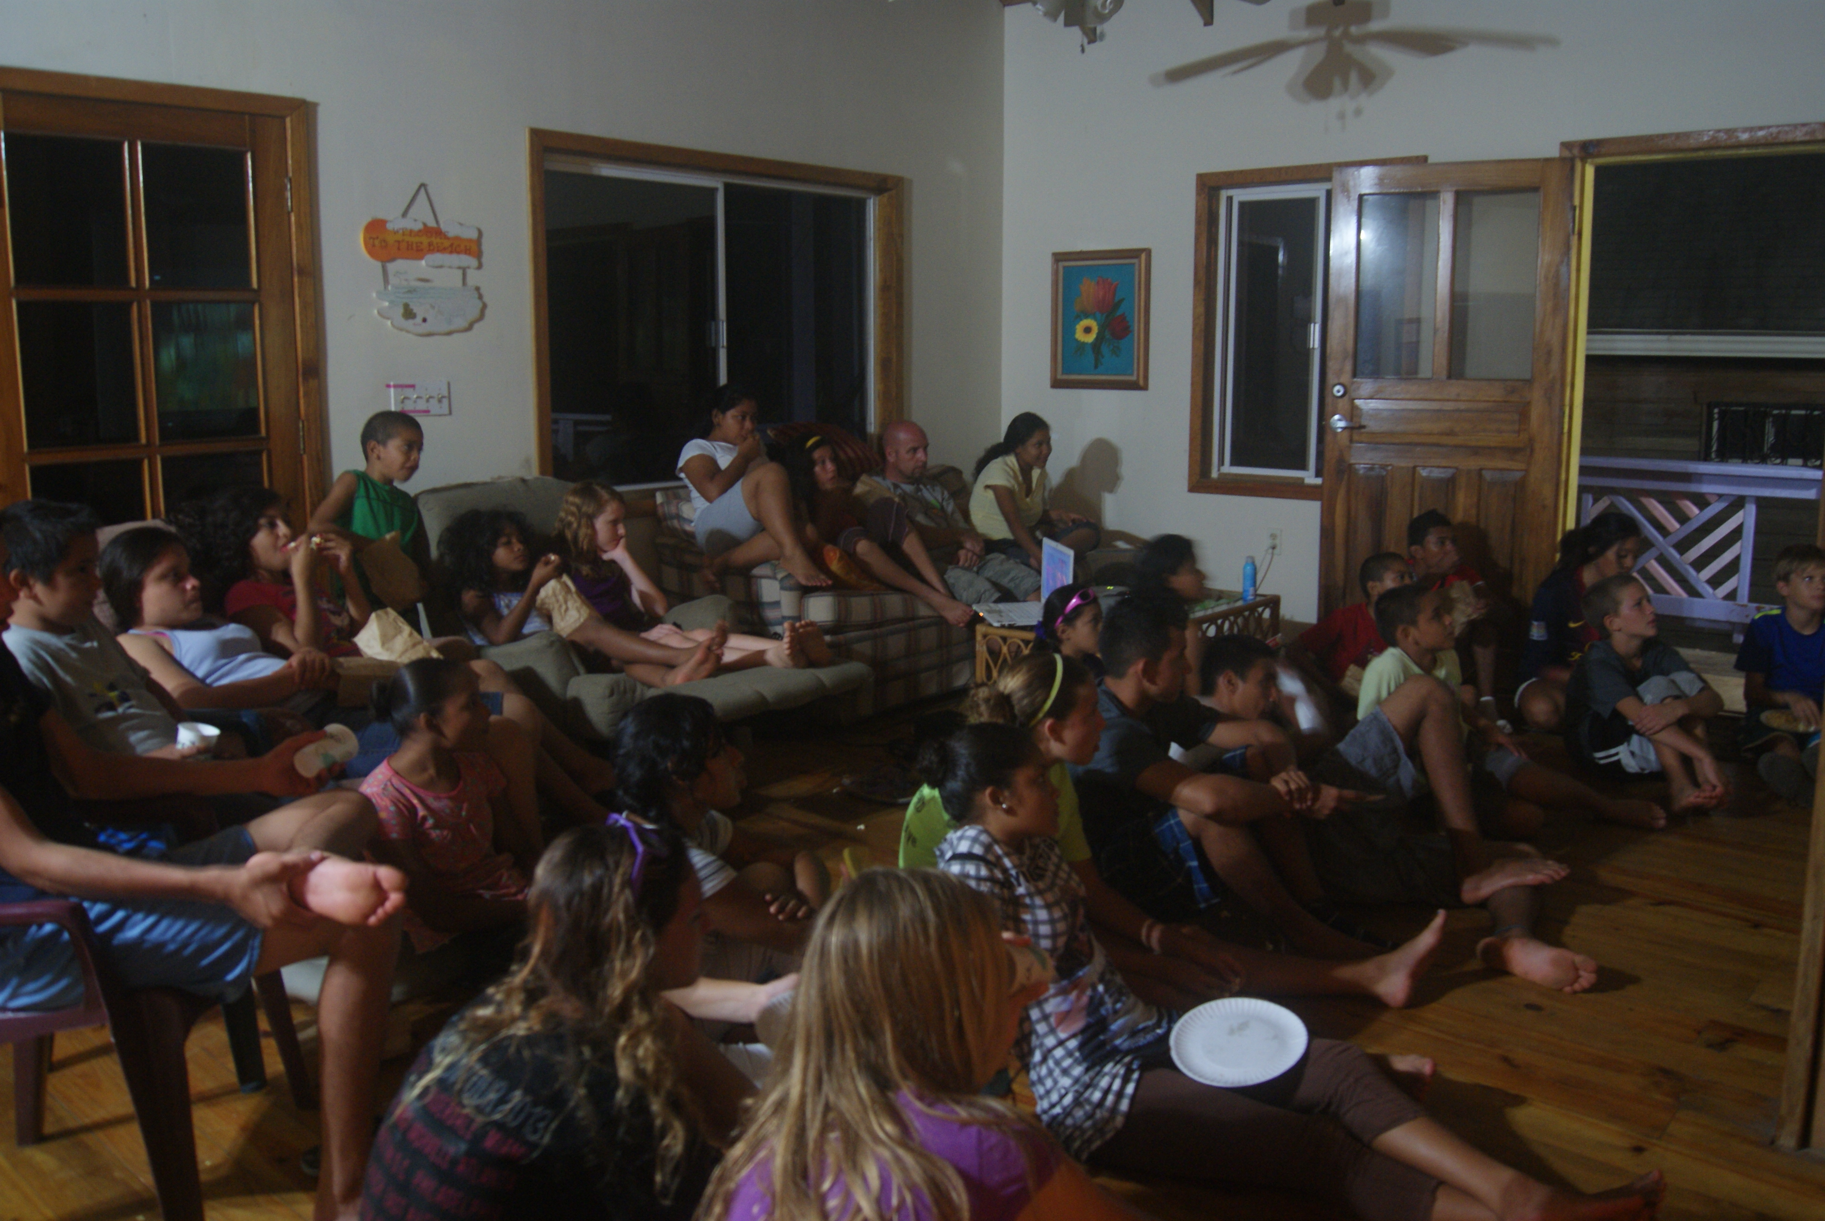
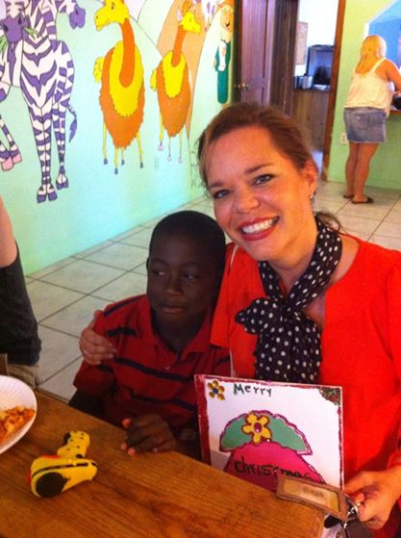
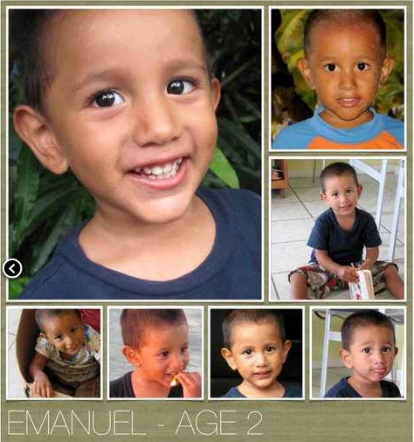

Slide 11
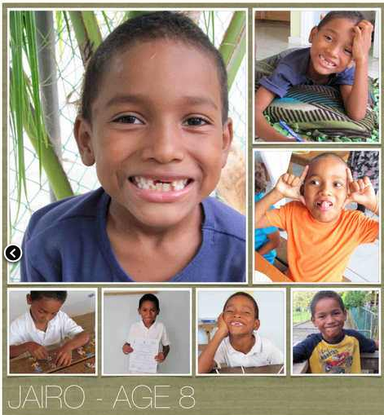

Slide 12
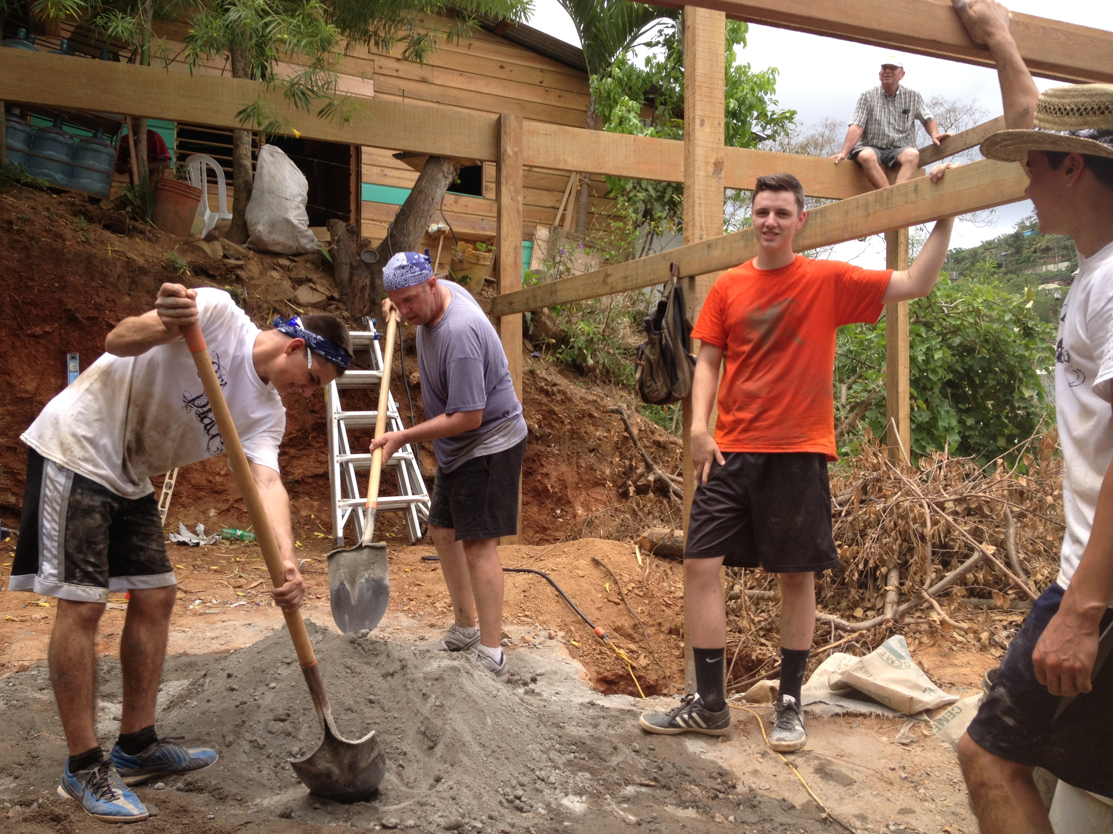

Slide 13
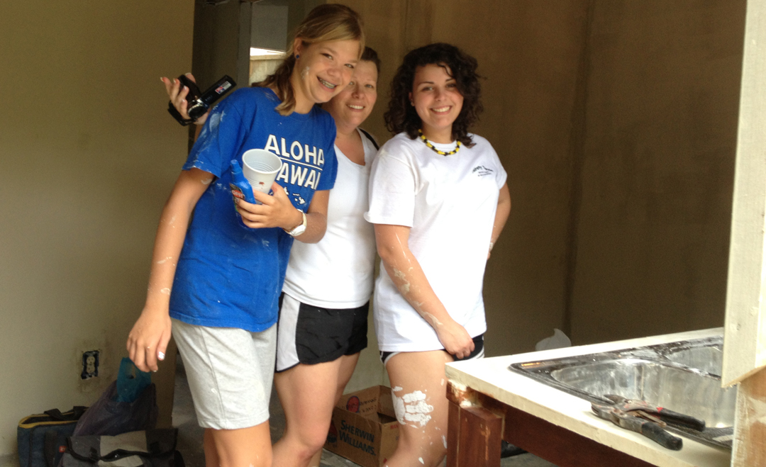

Slide 14
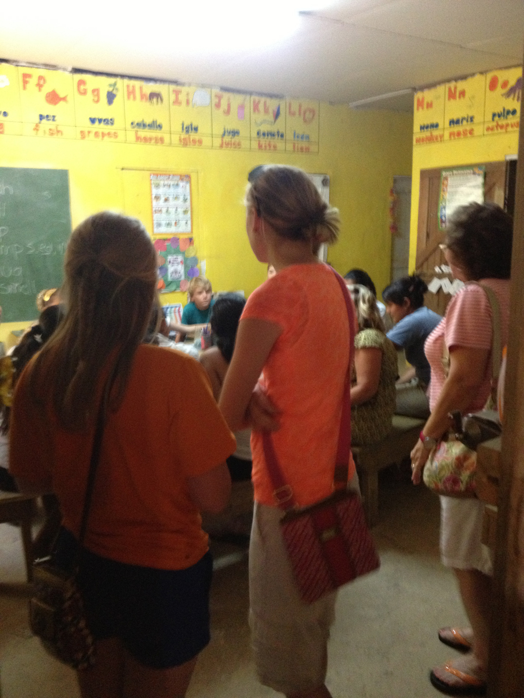

Slide 15
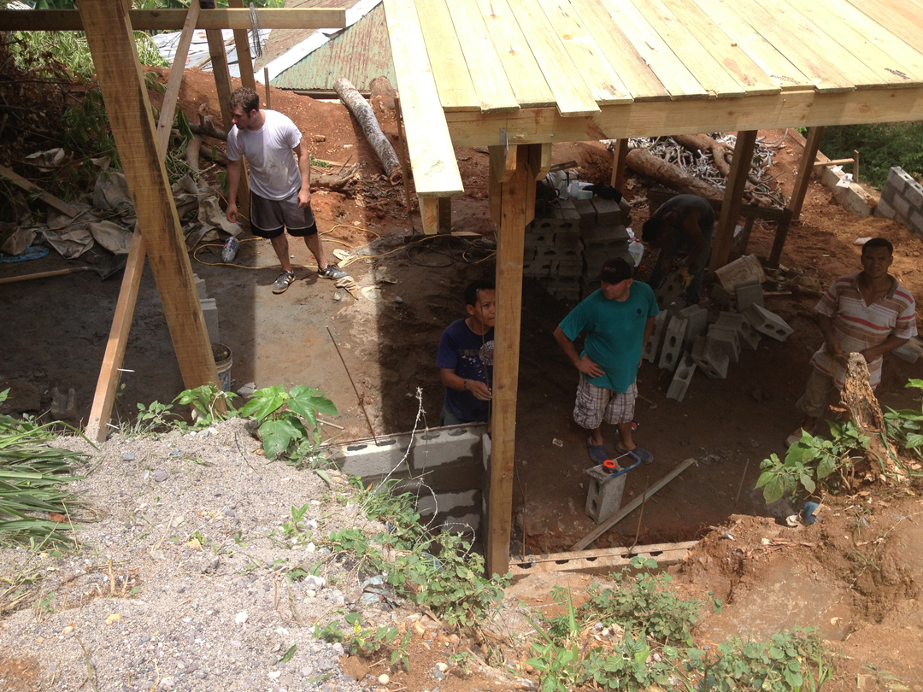

Slide 16
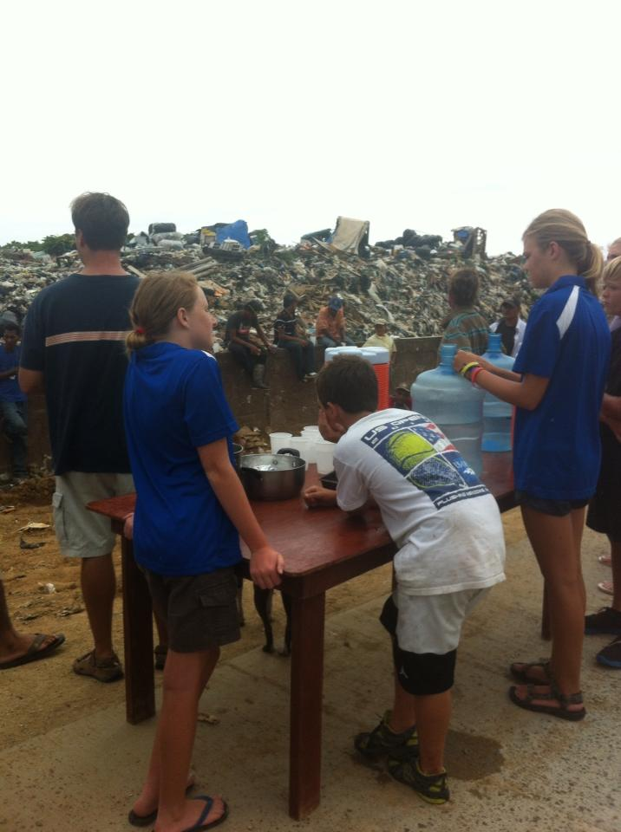

Slide 17
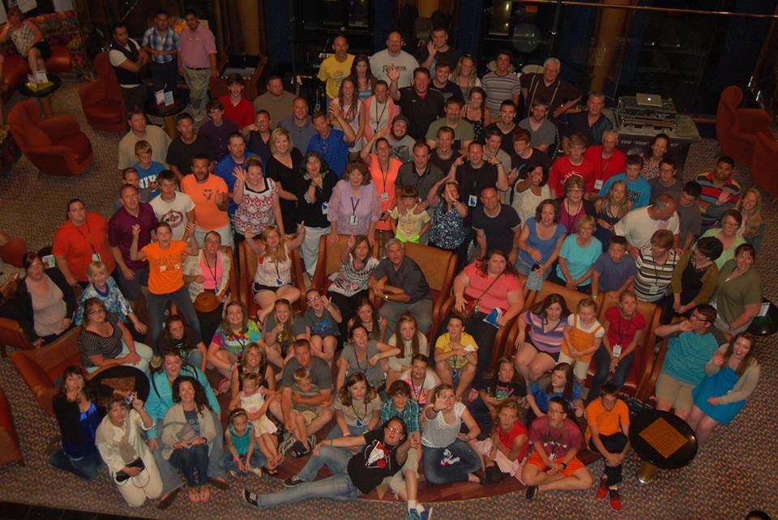

Slide 18
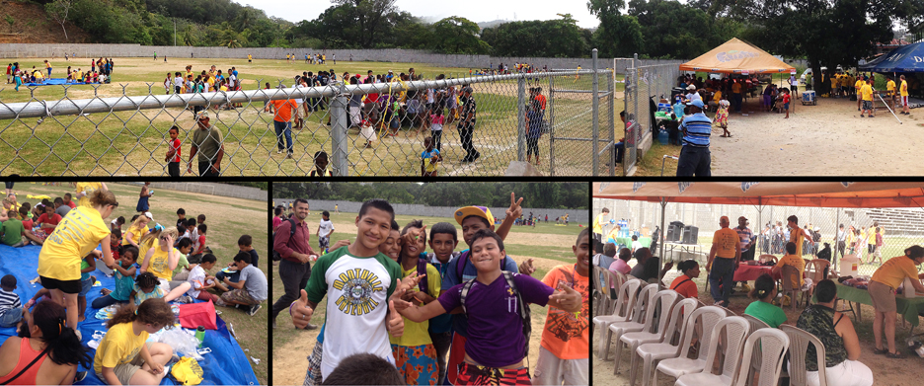

Slide 19
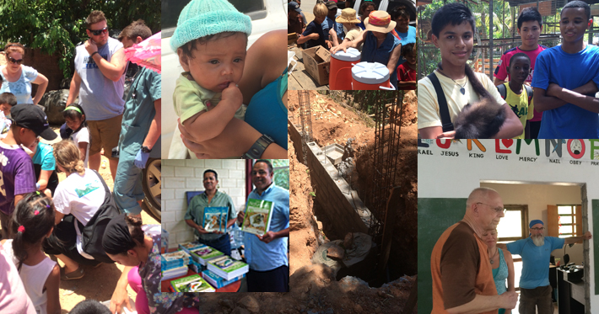

Slide 20
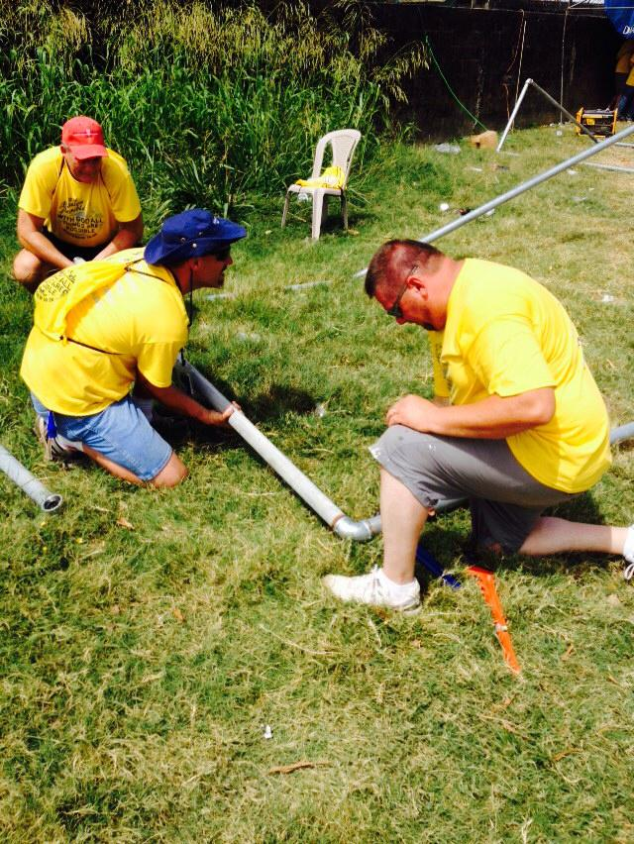

Slide 21
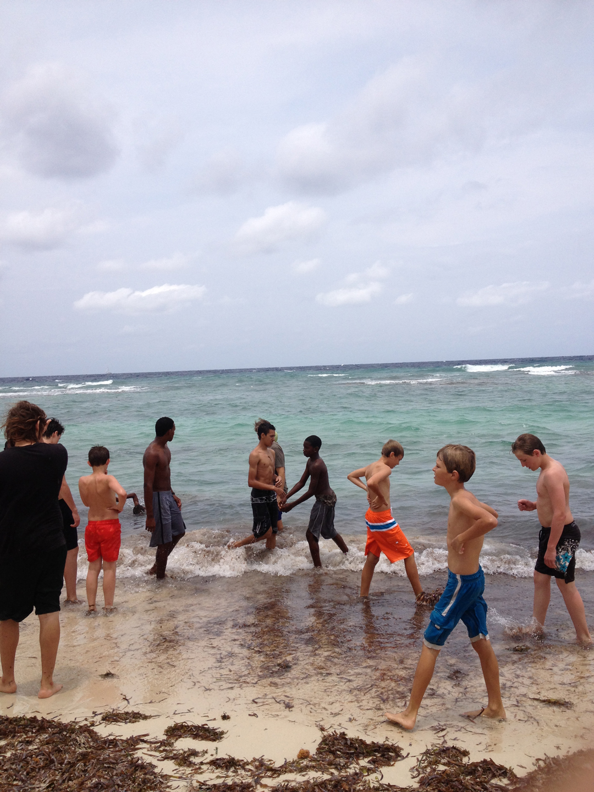

Slide 22
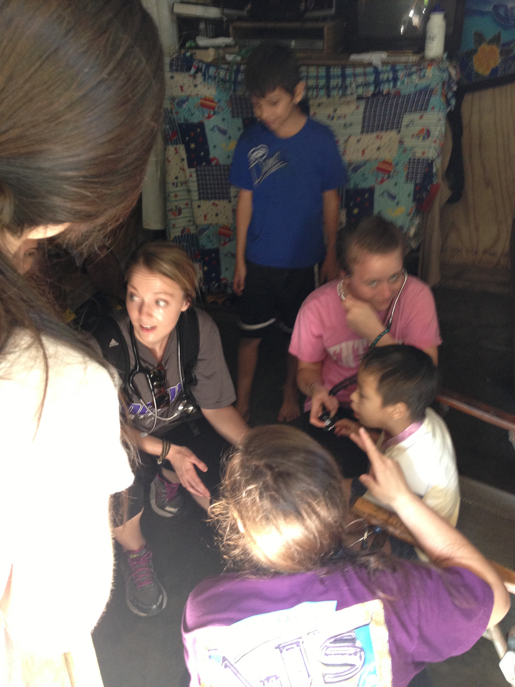

Slide 23
www.ROATANMISSION.com

